Slide 1


Right Place + Right Timing = Market Share
Using Data to be in the Right Place, at the Right Time.
Title Toolbox, by Benutech, Inc.

Slide 2

About Us
Collaborate, Assist, and Empower your Realtors and Lenders.
Homeowners don’t sell without reason. Homeowners don’t refinance for fun. They need reasons to sell, reasons to refinance. Those reasons are often spurred by “life events” or other circumstance.
Title Companies utilize Title Toolbox to provide advantages and marketing insight to their clients. Client access is free from their Title Company. Sites are branded to the Title Company providing scalable, turnkey solutions to help clients expand their businesses.
Title Toolbox identifies probable sellers before they list their homes. It then provides all the research tools and reports that both Realtors and Lenders need to move smart and fast in market.
Benutech, Inc. offers an unparalleled approach to providing real estate related companies with both innovative technology and elegant data solutions. We take on the viewpoint of our customers, understand their data challenges and needs, then quickly build the data solutions that allow them to grow the most streamlined, efficient, and productive business models available.

Slide 3
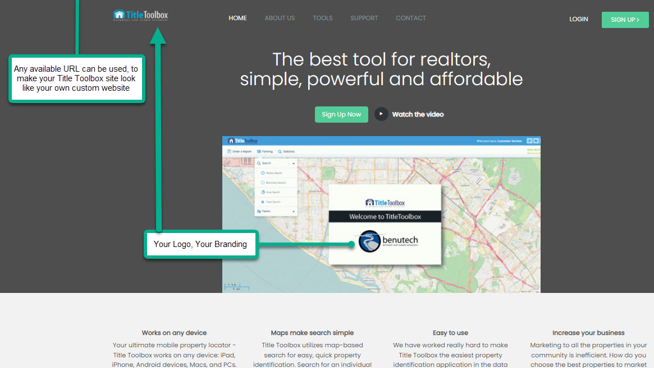
Every Data Detail
Title Toolbox is a revolutionary platform that enhances the delivery of property data and property reports to help the subscribing Title Company successfully grow and retain their business and clientele. With Title Toolbox, users have instant access to all of property information, property details, property reports, and tools that their State regulations will allow for them to deliver to their clients. All the “Tools” in Title Toolbox have been proven to help Realtors and Lenders successfully market and prospect for new business.
Assessor Info (Owner names, site & mailing addresses)
Property Characteristics (Beds, baths, sq. ft., lot size, stories, and all other characteristics)
Assessments & Taxes
Transaction History (all transfers, including full and partial [trust] transfers)
Lender History (all loans, including those paid off, or otherwise reconveyed, incl. defaults)
Mortgage Leads (Any filter, for any loan target)
Realtor Leads (Life Events, liens, defaults)
Notes:
General: State, County, City, Zip Code, Address, Owner Occupied
Property Characteristics: Bedrooms, Baths, Property Type, Year Built, Lot Size, Building Size, Number of Units, Year Built, Other Specific Details
Assessments & Taxes: Assessed Value, Purchase Date, Assessed Land Value, Purchase Price, Value of Assessed Improvements, Percent Improvement, Year Assessed, Amount of Delinquent Taxes, Most Recent Year of Tax Delinquency, Tax Rate Area, Tax Year, Other Specific Details
Other: APN/Parcel Number, Census Tract, Mail Carrier Route, Site Carrier Route, Site Extended Zip Code, Tract Number, Zoning Code, Title Company
Custom Filters: Out of Sate Owners, Next Sellers, Non-Owner, Recent Change, Full Sale in the Last 12 months, Empty Nester, Even House Number, Odd House Number, Residential Vacant Land
Mortgage Info: AVM Final Value, First Lender, First Loan Date, First Loan Estimated Interest Rate, First Loan Amount, First Loan Type, First Loan Interest Rate Type, Second Loan Amount, Second Lender Name, Second Loan Stamped as a Line of Credit, Second Loan Date, Loan to Value Ratio
Leads: Affidavit of Death, Bankruptcy, Divorce, Eviction, For Lease By Owner, For Sale By Owner, Lien, Lis Pendens, New REO, Notice of Default, Notice of Trustee, Probate

Slide 4





Data & Services
Phones/Emails
Mortgage/Equity
Life Event
Net Sheet Calculators
Reports
Benutech has partnered with a third party vendor to provide phones and/or email addresses on property group that you select. They tend to match phones to property addresses on 75% of a list and charge 5 cents per phone number found. They tend to find email addresses on 35% of a property list and charge 7 cents per email.
Interest Rate
Loan To Value
Phone Numbers
Emails
Lender Name
HELOCs
ARMs
Refi Loans
Purchase Loans
Search by County, Zip, City
Owner occupied / Non Owner Occupied
Loan Date
Value of Home
Loan Amount
Affidavit of Death
Bankruptcy
Divorce
Eviction
Lien
Lis Pendens
Notice of Default
Notice of Trustee
Probate
Cash Buyers
We offer the ONLY net sheet calculator that uses a Nationwide data file to post the current market value of each property (AVM), the current property taxes, and the open mortgages on each property instantly. This allows for a “1-click”, instant information solution to provide Realtors and Lenders and their clients with net proceeds for sellers, down payments and payments for buyers and refinancing borrowers.
Profile with Comps
Property Profile with Demographic data
Property Profile with School Data
Property Profile with School and Demographics data
Single Page Profile
Buyer Tax Estimate
Prep Report
Buyer Tax Estimate
AVM
Lead Sheet
Net Sheet

Slide 5





New Listing Opportunities, Leads delivered
Involuntary Liens
Divorce Filings
Probate/Affidavits of Death
Bankruptcy Filings
Empty Nester
IRS liens
State Tax liens
Utilities liens
Property Violation liens
Mechanics liens
Available Nationwide
22.8% result in sales (12 mos)
Many more result in Refi’s
Great listing leads
Available in major metros
19.7% result in sales (12 mos)
Affidavits of Death (2 were on title, 1 passed away, 1 left on title)
Great investor leads
Great listing leads
Available Nationwide
Largest household bill, generally
is the mortgage payment
Bankruptcy may delay sale, but these filings leads to sales
Great listing lead
Great investor lead
Available Nationwide
Biggest lead type resulting in MLS listings
Elderly, and older sell often
Today healthy, tomorrow?
Move closer to kids
Move closer to grand kids
Available Nationwide

Slide 6





Lending niches, Leads delivered
FNMA Refi Now
FHA Streamline
HELOC Eligible
Drop PMI Eligible
UPB under Jumbo Loan Amount
Owner Occupied
1-unit only
No mortgage defaults (12m)
No second mortgages
Income < 80% of median for the Census tract
LTV < 97%
30 yr loan serviced by FNMA
Origination Date 6/2011 to 6/2020
FHA loan present
FHA loan seasoned 12+ months
No mortgage delinquencies
Rate lowered by 1%, or
Payment lowered by $50 or more
Only 1 mortgage present
No mortgage defaults
LTV of 65% or less
Owner occupied
Original 1st Mortgage LTV > than 80%
Current LTV < than 80% LTV
Only 1 loan present
Original loan >/= Jumbo loan limits
Current UPB lower than current Jumbo loan limits.
Conventional loan limits increased, identify loans that newly qualify conventional

Slide 7
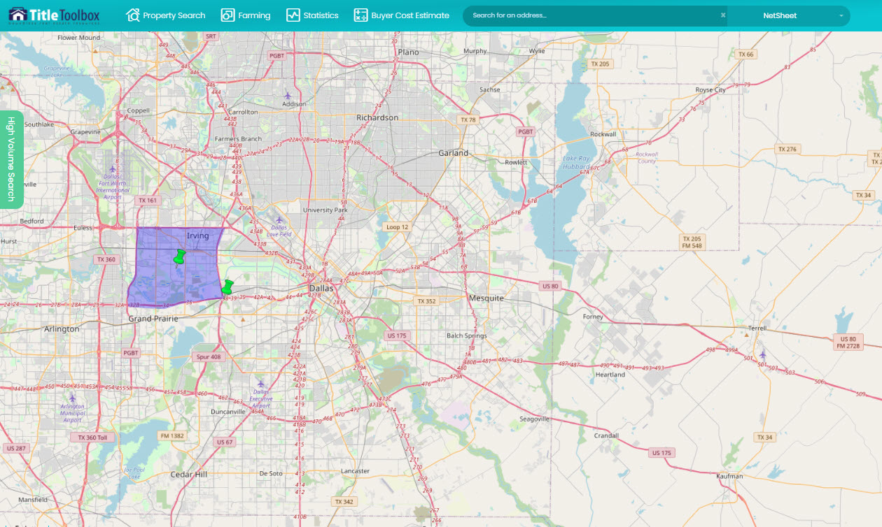
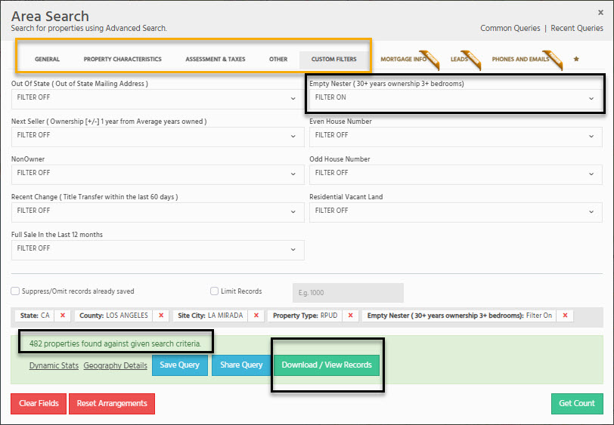
Basic Assessor Search
Title Toolbox is a revolutionary platform that enhances the delivery of property data and property reports to help the subscribing Title Company successfully grow and retain their business and clientele. With Title Toolbox, users have instant access to all of property information, property details, property reports, and tools.
Assessor information being “Public Information”, most State regulation will allow Title Companies to provide this information to their clients at no cost – but this data can be structured to be client paid, where needed.
Search by beds, baths, owner name, subdivision, owner occupancy, etc.
Easily identify “nearby neighbors” for just listed, just sold, or open house campaigns
Sort by purchase date, purchase price, tax default status
Identify postal carrier routes (for EDDM) mailings; Sort areas from highest turnover rate to lowest turnover rate
Search by “Empty Nester” criteria, which is the biggest listing lead going on to the MLS.
Search by “Next Sellers” or “Out of State Owner” – all which lead to home sales.

Slide 8
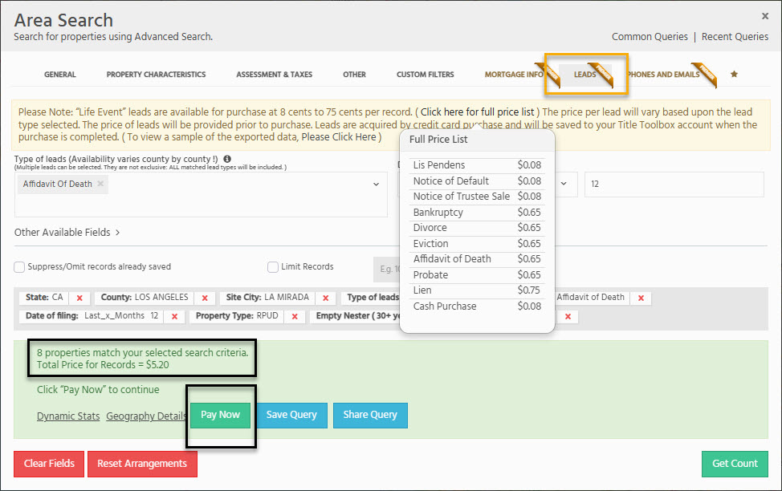
Listing Leads Search
Title Toolbox is a revolutionary platform that enhances the delivery of property data and property reports to help the subscribing Title Company successfully grow and retain their business and clientele. With Title Toolbox, users have instant access to all of property information, property details, property reports, and tools.
Turnover rate being only 4% on average nationwide – Listing leads allow Realtors to focus on properties that have 5-times or higher rates of sale. These addresses sell significantly faster, and help Realtors be more successful in their efforts, by being in the right place, at the right time.
Lead types vary by county, by state; yet most of the Listing Leads are available throughout the U.S.
Mortgage defaults/ Lis Pendens (51.7% rate of sale)
Divorce filings (22.8% rate of sales)
Probate/Affidavits of death(19.8% rate of sale)
Bankruptcy filings (available nationwide).
Liens (available nationwide, include IRS liens, State tax liens, and any other involuntary lien)
For Sale by Owner

Slide 9
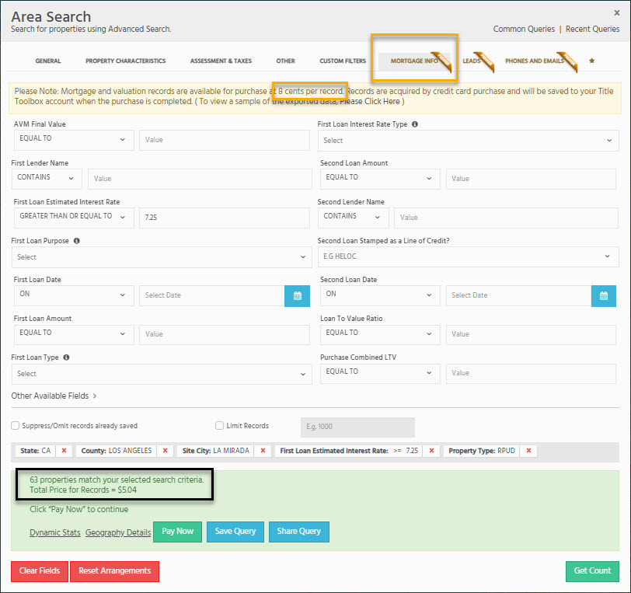
Lender Lead Search
Title Toolbox is a revolutionary platform that enhances the delivery of property data and property reports to help the subscribing Title Company successfully grow and retain their business and clientele. With Title Toolbox, users have instant access to all of property information, property details, property reports, and tools.
Your Lender clients are always looking for advantages in marketing, and the right data can point them to the best candidates for their specific lending niches.
Lenders can search by any filter they need to target homeowners that are more likely to refinance or to target for a HELOC or 2nd.
Filter by interest rate, lender name, loan amount, origination date, etc.
Sort by current market value (AVM), by Loan to Value (LTV), or interest rate
Target reverse mortgage loans
Layer multiple filters to target homeowners that can remove PMI, qualify for new conforming loans, or are streamline refi eligible

Slide 10
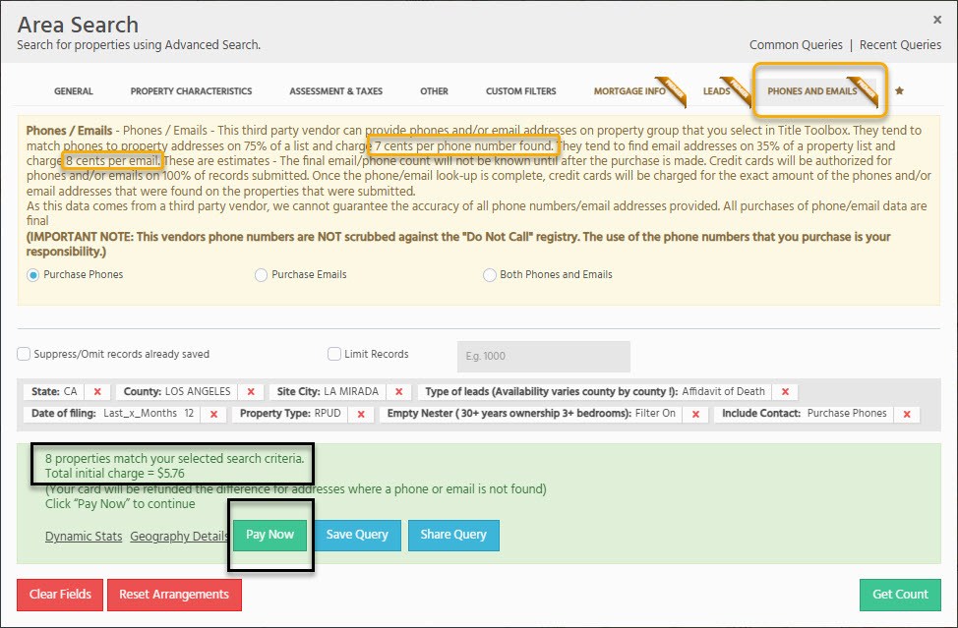
Contact Information Search
Title Toolbox is a revolutionary platform that enhances the delivery of property data and property reports to help the subscribing Title Company successfully grow and retain their business and clientele. With Title Toolbox, users have instant access to all of property information, property details, property reports, and tools.
Your clients need access to good, quality contact information (phones and/or emails). Truth is, a postcard costs 60 cents or more, and are only a 1-time use. Phones and emails can be used as often as needed and are significantly less expensive.
Phones and Emails are available nationwide, are sourced to the Owner name and mailing address.
Phones found on 75% of property at a cost of 5 cents per address.
Emails found on 35% of property at a cost of 7 cents per address
Phones and emails can be purchased on a single property, groups of property (farms), and on uploaded lists of property
We ran 2.5M records for contact info, delivered them to clients over 5 months, and this vendor won, and won big on quality.

Slide 11
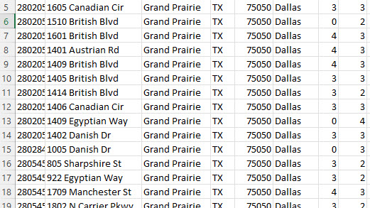
Data Delivery as it Should Be Delivered
Most Title Companies deliver property data to their customers in Excel spreadsheets or disconnected apps… and those spreadsheets don’t update themselves, nor do they have all of the research information Realtors and Lenders need – Such as sales comparables, net sheets, maps, or access to contact information (phones/emails)
So, we don’t deliver data like most…

Slide 12
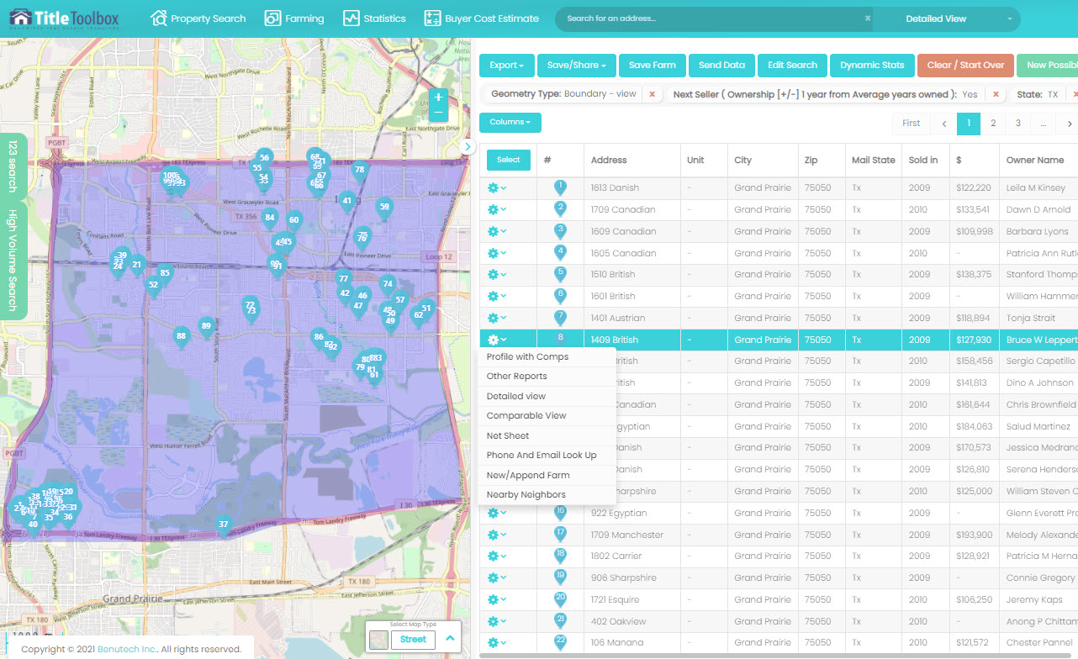
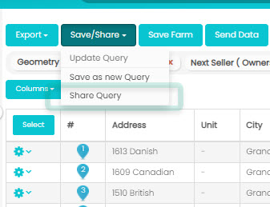
Data Delivery as it Should Be Delivered
Most Title Companies deliver property data to their customers in Excel spreadsheets or disconnected apps… and those spreadsheets don’t update themselves, nor do they have all of the research information Realtors and Lenders need – Such as sales comparables, net sheets, maps, or access to contact information (phones/emails)
We deliver data as it should be delivered…

Slide 13
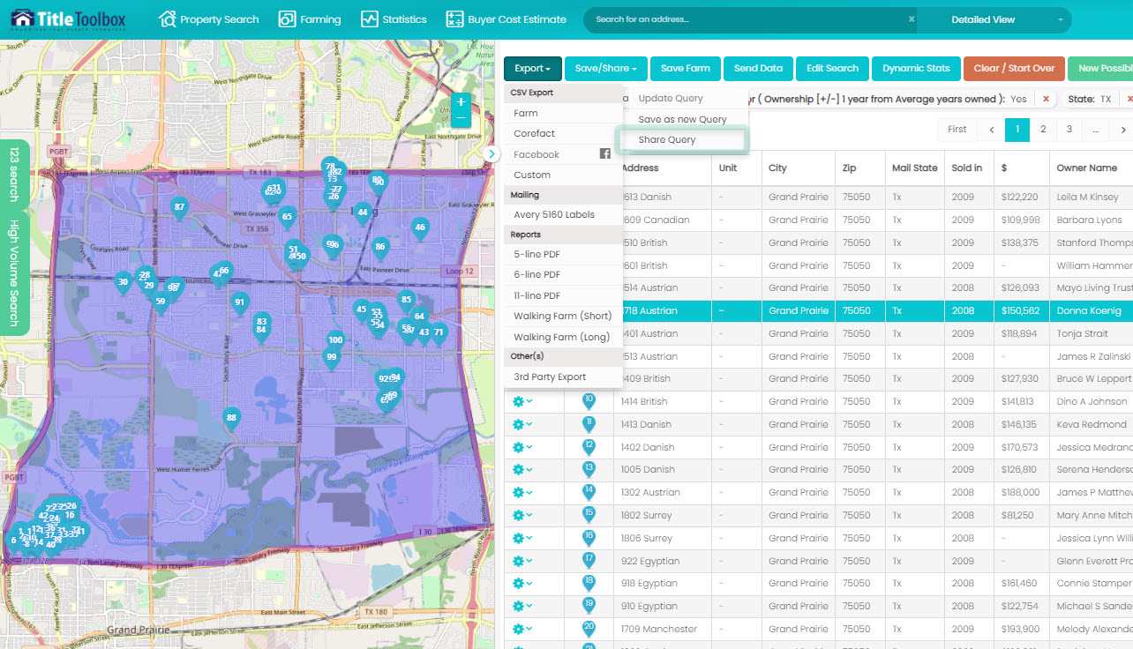
Research any Property
Title Toolbox is the ultimate “One-Stop-Shop” for Realtors, Investors, and Lenders.
It identifies the most “Probable” sellers or refinance candidates in any market.
It provides all basic farming or targeting filters for basic searches such as Just Listed/Sold or Open House marketing.
It then organizes and updates those farms/lists every day, automatically, so that the User is always dealing with the most current owner information and contact info.
From there the User can purchase phones/emails or both.
The User can export the records in several formats, including the exact format that imports without alteration into Facebook, for Ads to be posted within Facebook for Seller or refinance targeting.
And farms/lists can be shared from one User to another, allowing for seamless and easy interaction amongst Title Rep to Client or amongst real estate teams.

Slide 14
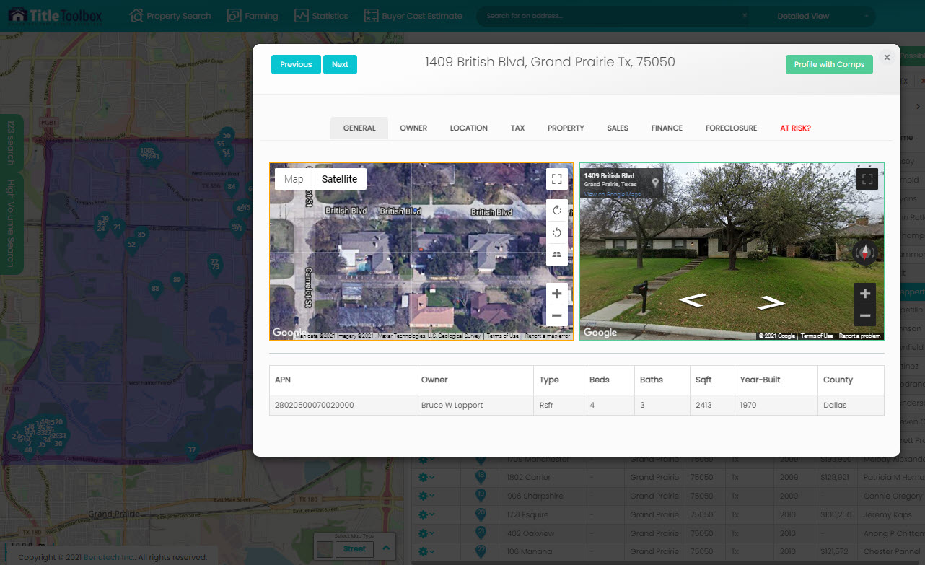
Detailed Maps and Property Information
Title Toolbox provides the same aerial and street view maps that Google provides. Huge time-savers for Realtors and Investors that need to see what the home looks like before driving to it.
From there, Title Toolbox has all of the information that Google does not have, like complete transfer history of the property, lending history on the property, whether or not the property is in foreclosure currently, owner info, tax roll information. Anything that a Realtor, Lender, or Investor would need to know on the property is available by looking up property 1 by 1, or on any property within a farm/list.

Slide 15
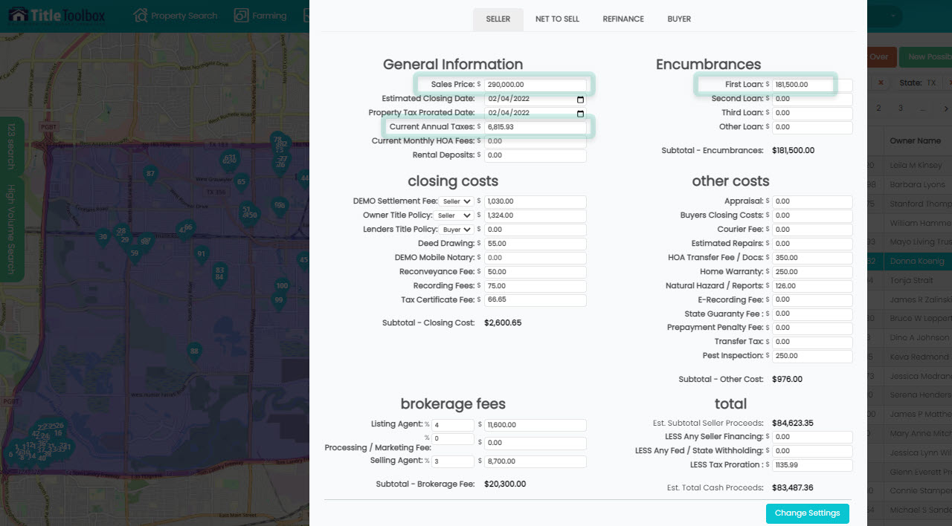
Net Sheet and Buyer Estimates
Title Toolbox provides the only Net Sheets application that pre-populate the current market value of homes (via AVM), the current property taxes on the property, and the current open loans. This allows the user to instantly know the current market value, net proceeds for a seller, and allows the user to know what loans are present and what the property taxes are on the property.
Think about standing on a doorstep (or on a phone call), and the seller says: “I don’t know what my house is worth, or what I would walk away with (if I sold)...” Do you want to have to take a time out to research values, taxes, and loans and then later answer those questions? Or do you want to have that information readily available?
It’s simple… having that data available allows the Realtor, Investor, or Lender to continue the conversation with the Seller without having to come back tomorrow (or call back later).
It’s the most complete Net Sheet on the market today.

Slide 16

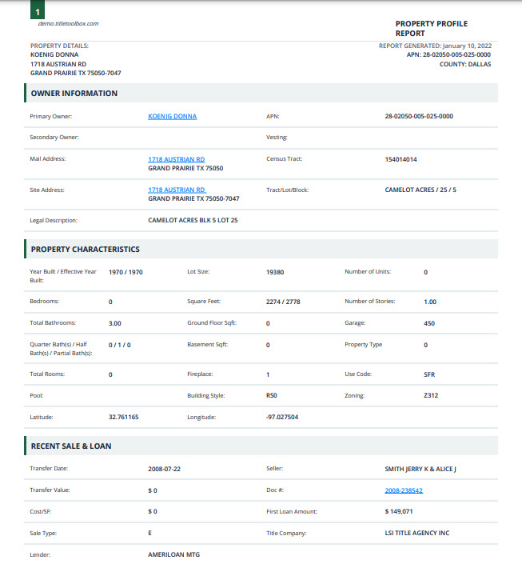
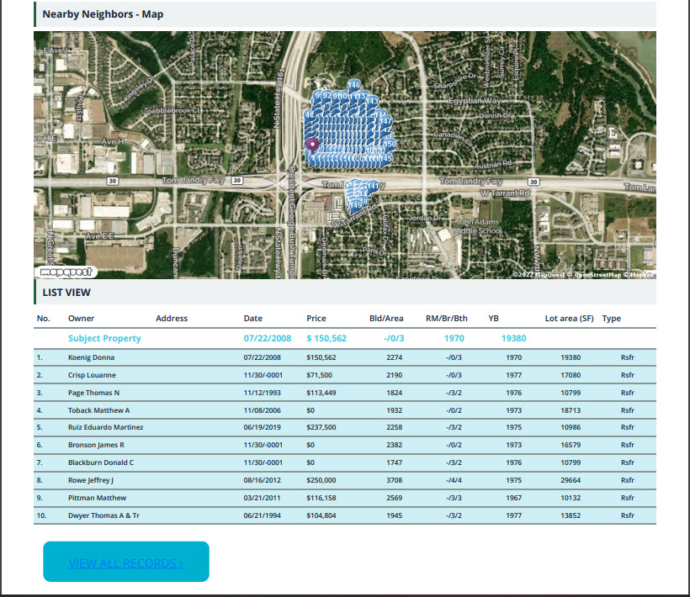
Property Profile Reports

Slide 17






Thank You
Brian Fox
714-580-8099
brian@benutech.com
www.benutech.com

